Slide 1

API Development Proposal
Oct 2014

Slide 2
Agenda
Our Understanding
Scope
Schedule & Coverage
Team
Governance
Assumptions & Dependencies
Risks & Mitigations
Pricing
Ness Differentiators & Credentials

Slide 3
Our Understanding
Dealertrack uses Innotas (SaaS solution) for employee information, time tracking, etc.
Innotas provides API to access its data which is currently being accessed by Jira, KPI portal, Business intelligence Reporting etc. applications
Innotas APIs’ provides access to confidential data that is currently being consumed by end applications which his not desirable
Dealertrack does not want this confidential data to be exposed to the end users using Innotas API’s
Innotas API framework does not provide a mechanism to authorize users to consume confidential data

Slide 4
Scope
Design a solution that provides a mechanism to restrict user access to confidential data
Proposed solution should be extensible and scalable to meet current & future needs of Dealertrack
Proposed solution should have minimum impact on existing applications that are consuming Innotas APIs’ today
Proposed solution should confirm with existing Dealertrack architecture standards and technology tools
Innotas has 1 ServiceCall with 48 methods that need to be protected with the new solution

Slide 5
Out of Scope
Changes to end applications consuming Innotas APIs’ today
Performance testing
Any items not mentioned In Scope

Slide 6
Innotas API Solution Approach- High Level
Solution Approach
Implement an abstraction layer between DT applications accessing Innotas API and the Innotas API
All access to Innotas API will be through the abstraction layer
Application/User access to Innotas API can be setup through a Custom Rules Portal which will store these Rules in a Database

Slide 7
Innotas API Solution Details
Permissions can be managed at one of the 2 levels i.e. Application level permissions or User level permission. From our current understanding permissions at Application level will be apt for the solution.
Permissions will be set from a Web application that will be built using Python (DT 2.0 architecture standard). Permissions will be stored in an Oracle Database
Applications will access the Abstraction layer APIs’ using SOAP based services over HTTP
Abstraction layer can handle the data request when user does not have permissions in 2 ways (to be decided with DT consultation) :
Reject the request returning back error message to the user
Remove/Mask confidential data before sending response to the user
Abstraction layer will be built on Mule ESB (standard DT 2.0 architecture standard)
Mule ESB will use Rules database to authenticate & authorize access to confidential data.

Slide 8
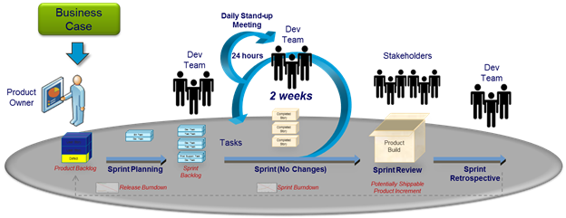
Execution Model – Design & Development
Agile based execution model with 5 sprints
Discovery Sprint
Development Sprint 1
Development Sprint 2
Hardening Sprint
UAT Sprint
.

Slide 9





Governance
Project Team & Governance Structure – Dealer Track and Ness
DT
Ness Onsite
Issue Escalation
Contractual Changes
Ness Support Groups
DT Leadership Team
Ness Relationship Manager
DT Program Manager
Ness Program Manager
Joint Reviews
Program Health Check
PMO
DT Project Manager
Lead
Technology
Practices
Delivery Head
Ness Offshore
DT Team
Project Manager
Other Support Groups
Ness Leadership
Leads
Ness Support Team
Developers
Ness Team

Slide 10
Proposed Team
Role | Skillset | Responsibilities | Location

Slide 11
Assumptions & Dependencies
Permissions will be based at Application level and not User level
DealerTrack will provide all required software licenses
DealerTrack will provide all required access to DealerTrack & Innotas application

Slide 12
Schedule & Timelines

Slide 13
Risks & Mitigation
# | Phase | Risk | Description | Probability | Owner | Mitigation Strategy
1
2
3

Slide 14
Pricing
Terms & Conditions
v

Slide 15
Differentiators & Credentials

Slide 16
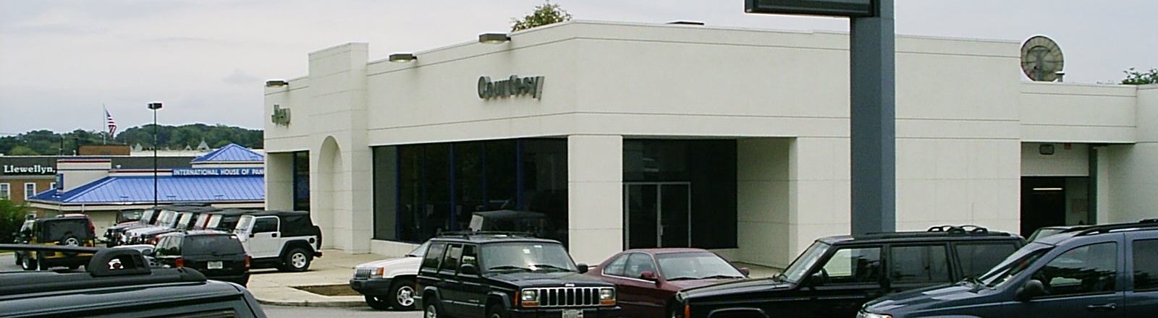

#7 DealerTrack SEC Overview
Established in 2001, Dealertrack provides software solutions and services to enhance efficiency and profitability for all major segments of the automotive retail industry
Ness has been operating an SEC for DealerTrack since 2011 in Hyderabad, India
Ness involved in Architecture and Common Product Framework Development for their Dealer Management System
Key Services include Technology Migration, Product Rebranding, Application Security Remediation, Process Consulting and Engineering Tools Implementation & Integration
Provided a creative solution partnering with IPV to rebrand DT products to new logo
Improved the availability and scalability of the systems through a highly scalable architecture for the current legacy systems
Improved customer experience and increased capability to cross-sell, up-sell through a common reference data integration between various products
Improved time to market of flagship products through accelerated its adoption of open source platforms
Reduced Total Cost of ownership of its product platforms
Notes:
The Client : Dealertrack Technologies (Nasdaq: TRAK), which was established in 2001 and is headquartered in Lake Success, N.Y, provides high-value and intuitive web-based software solutions and services to drive efficiency and profitability for all major segments of the automotive retail industry, including dealers, lenders, OEMs, third-party retailers, agents, aftermarket providers and other service providers.
Specialties - Automotive, Technology, Lender Solutions, Dealer Solutions
Domain : Retail
No of Resources : 35 (Onsite) + 35 (Offshore)
Technology Stack : Java/J2EE, .Net, Python, QA- Automation(Selenium). Tools – Blade Logic & Atlassian
Emerging Technologies : Python, Data Power
Type of work :
• Product Design and Development Services
o Architecture and Common Product Framework Development
o Technology Migration
o Technology Evaluation
o Product Development
o Product Maintenance (Bug Fixes, Support) and Enhancements
• Testing Services
o Manual Testing (Functional, Regression)
o Test Automation
o Performance Testing
• Application Security Remediation
• Product Rebranding Solution and Implementation
• Engineering Effectiveness - Ness Smart Platform Implementation
• Process Consulting – PDLC and Build/Deployment Process Improvements
• Consulting for Process definition, assessment
• Engineering Tools implementation and Integration
• Program Management and Scrum Coaching
Engagement Highlights :
Executed Projects in Scrum, Hybrid and Waterfall methodologies
Key Projects include:
Product Rebranding Solution and Implementation
Delivered a Bidding Engine Component on time for an online auction/bid site for their dealers
Transitioned 6 products maintenance offshore enabling DT to take up new product initiatives.
Engineering Effectiveness - Ness Smart Platform Implementation
Application Security Remediation
Process Consulting – PDLC and Build/Deployment Process Improvements
Key Achievements
Platform/Architecture work
Delivered High Scalability Framework Components for .NET based Products
Helped evaluate new Technologies (Open Source) and conduct POCs
World Class Deployment – Taking over from IBM for the Implementation Phase
Consistent Zero defect deliveries
Helped create highly scalable architecture for the current legacy systems and adopting a common reference data integration between various products. This helped improve the availability, scalability of systems and also cross share reference data between products for better customer experience and increasing capability to cross-sell, up-sell
Helped Dealertrack accelerate its adoption of open source platforms and deliver one of its key flagship products to market with quicker turn around. Reduce Total Cost of ownership of its product platforms
Helping Dealertrack adopt a common and integrated set of tools with vast potential to improve productivity and improve analysis of engineering metrics.
Enabled quicker deliveries of product to market on the new open source platform
Helped complete rebranding of client facing products to enable one Dealertrack vision
Delivered High Scalability Framework Components for .NET based Products
Took Lead to consult & implement the NessSmart Platform ( Atlassian Tools)
Delivered BookOut Product (valuation of used Cars)– Earlier attempts by DT not successful
Delivered a Bidding Engine Component on time for an online auction/bid site for their dealers
Transitioned 6 products maintenance offshore enabling DT to take up new product initiatives. Introduced Test Automation and ensured consistent Zero Defect deliveries
Proactive build out of Python Technical Skills yielding new opportunities
Building Knowledge Base and Induction Material
Product Information, Whitepapers, Python Competency
Won & Completed DT Product Rebranding project against competition from IBM, White Hat partnering with IPV, Israel
Completed a Engineering Effectiveness Assessment for DT Canada and won next phase
World Class Deployment – Taking over from IBM the Solution and Implementation Phase
RTS – Partnering to undertake a major Technology Re- Platforming of their products
Thing you didn‘t know about the customer
Established in 2001, Dealertrack and its web-based software solutions and services enhance efficiency and profitability for all major segments of the automotive retail industry, including dealers, lenders, OEMs, third-party retailers, agents, and aftermarket providers.
Dealertrack operates the largest online credit application network in North America
Dealertrack has grown around 15-20% each in last 3 years and has made on an average 2 acquisitions over the last 10 years and is slated for $480 M revenue this year.
Headline achievement or Innovation within the lab
Provided creative solution partnering with IPV to rebrand DT products to new logo ( getting rid of old acquired companies logo and brand fragmentation)
Spearheaded definition of an Agile based Portfolio planning and PDLC process – helping move DT from Waterfall to Agile
Conceived, implemented and rolling out an integrated toolset using Atlassian / Jira with standard workflows, metrics for adoption as a single unified tool for engineering. This is helping DT move to a standard toolset and help improve productivity. The scope includes integration of Jira as a central tool with Salesforce, PPM tools, Selenium and Qmetry (testing) and with CI/Source code; enabling unified process for requirements, development, deployment, change control and customer request servicing.
Value Add
Implemented end to end integrated stack of tools including Atlassian JIRA tool stack and its integration to salesforce, Innotas, selenium, Qmetry to enhance engineering effectiveness and productivity
Help define Agile methodology based PDLC and enterprise portfolio mgmt. process using the same

Slide 17




Standard & Poor
GDS API Cloud
CHALLENGE:
To serve large number of customers across the globe the client wanted to build Application Programing Interface, there by:
Minimize network latency for the requests being served
Have 100% availability of services
Adding new hardware to the existing environment to scale up the applications
Amazon Web Services
Cloud
Environment
SOLUTIONS:
RESULTS
Created APAC & EU cloud regions in the Amazon and would be creating for more regions
Ease in scalability of new hardware
Implemented IDS (intrusion detection system)
Created three tier deployment architecture with Load balancer(Nginx), Webserver (Apache) and Application server (Weblogic)
Monitoring the performance of cloud databases & user activity
Monitoring systems availability in each cloud region
Implemented Rsyslog server (which collects and stores each instance syslogs to the centralized Rsyslog server)
Apache
Reduced costs: Reduces hardware networking management and overall IT expenses
Scalability: Ability to scale up or down easily
Virtually unlimited processing and storage capacity
Abstracted, pooled resources
High level of automation
Access to a huge range of applications without having to download or install anything
Applications can be accessed from any computer, anywhere in the world
Device and location independence
WebLogic
Rsyslog
RESULTS
Server

